Slide 1
Basics of FDM printing
Yuriy Sukhorukov @ysukhorukov,
BS17-RO “Adeptus Mechanicus”,
Innopolis Aerial Robotics lab engineer

Slide 2
Lecture outline
Printing process description
Printer kinematics
X, Y, Z movement
Extruder
Printer firmware
Printer choice
Slicing process & software
Post-processing

Slide 3
Printing process description

Slide 4
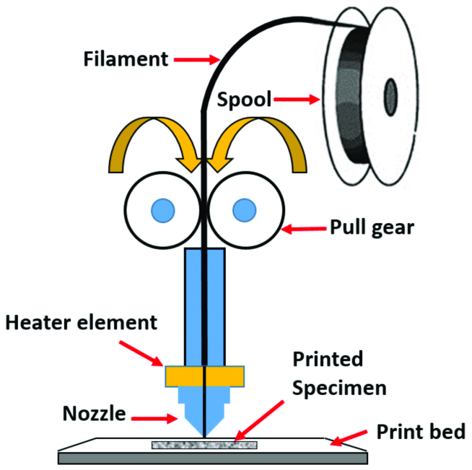
How does the printer print?
FDM - fused deposition modeling
Plastic is heated and pushed through a small orifice - nozzle
Nozzle block (printhead) can move in X, Y, Z directions
Molten plastic is deposited layer by layer to form solid object

Slide 5
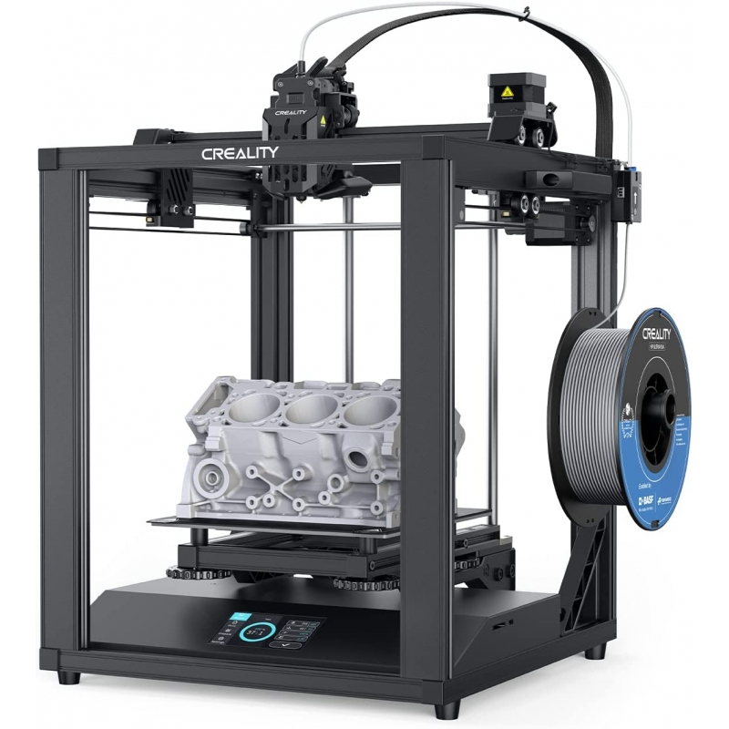
Printer parts
Printhead
Chassis
Gantry
Stepper
Rails
Belts
Printbed / buildplate
Printbed screws
Filament spool/roll

Slide 6
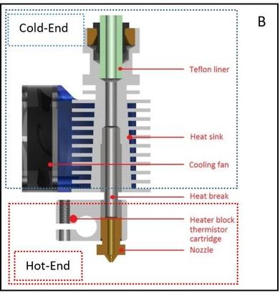
Printer parts
The printhead consists of several parts which insure that the printer works as intended
Especially important
Heatbrake
Cooling

Slide 7
Printer kinematics (X,Y,Z)

Slide 8
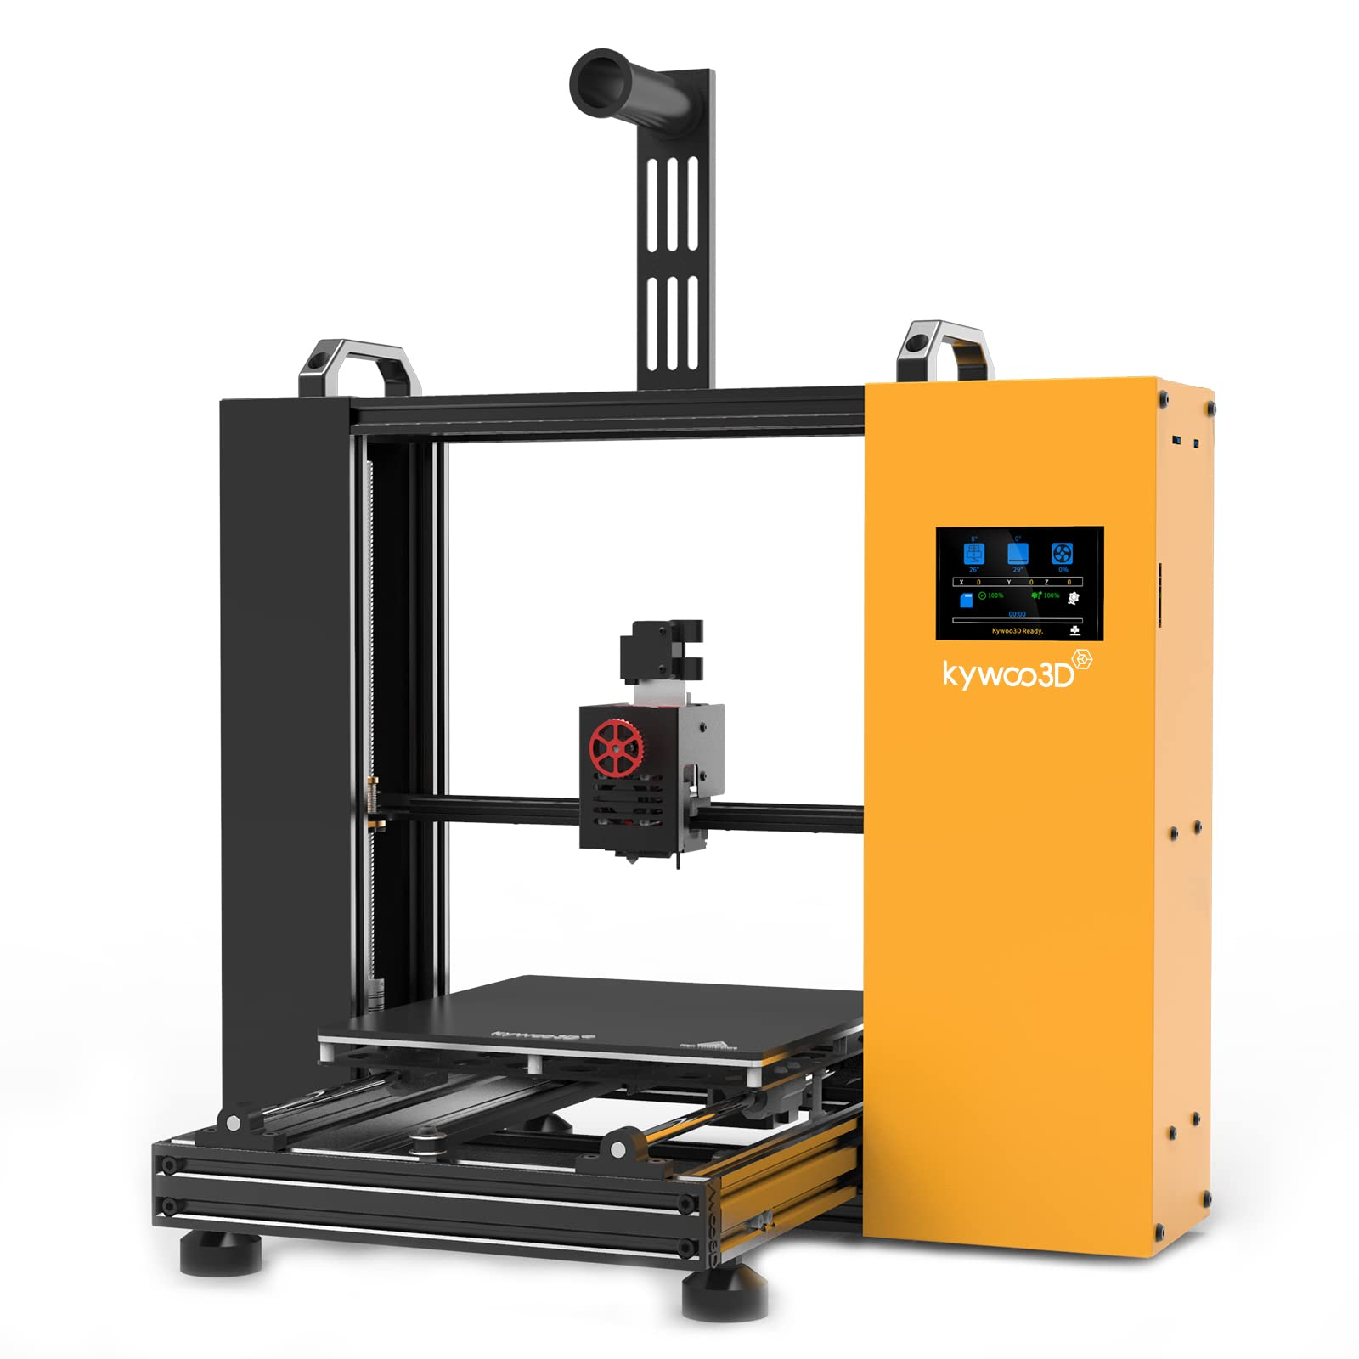
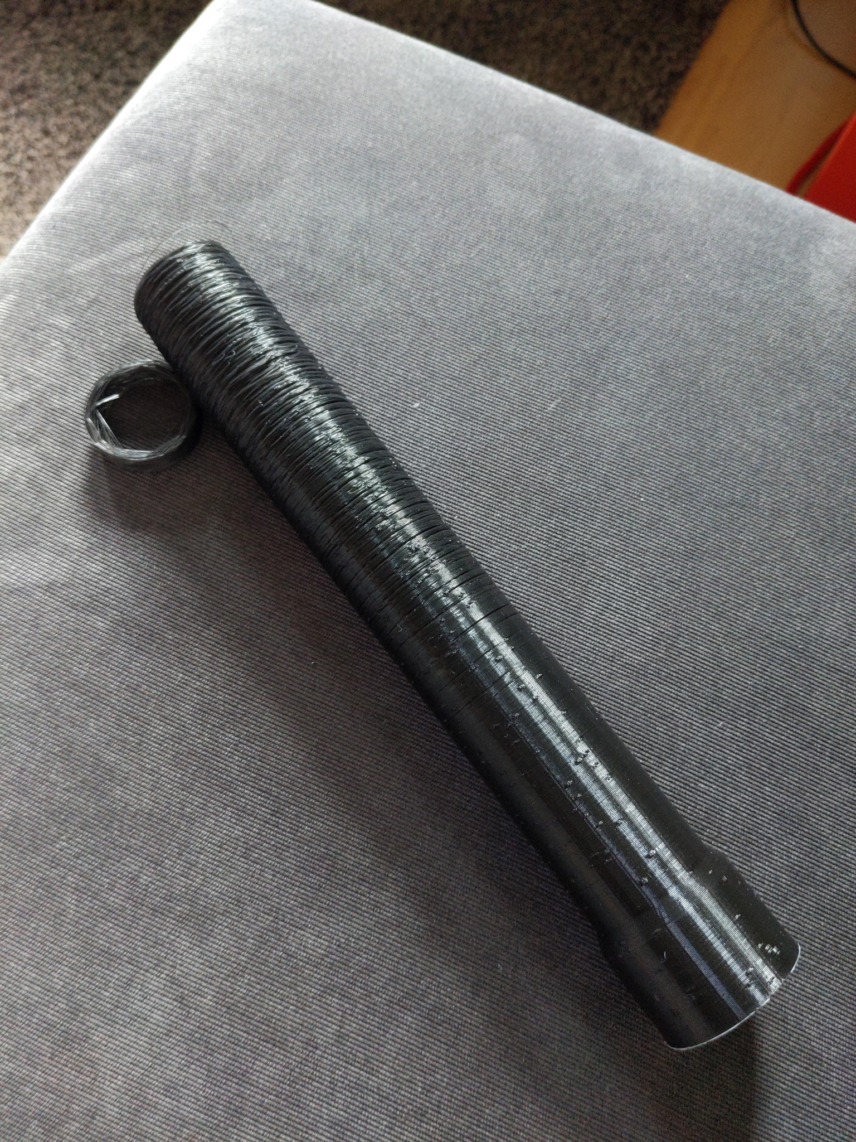
Bed-slinger
Printhead moves in X, Z axis
Bed moves in Y axis

Slide 9
Bed-slinger
Pros
Cheap
Simple
Cons
Y-axis is slower than X-axis
Possible artifacts on high accelerations and/or tall parts

Slide 10
Bed-slinger, specimens
Ender 3
Anet A8
Prusa i3
Longer LK4
Good for someone starting their maker’s career or for 3D printer farm

Slide 11
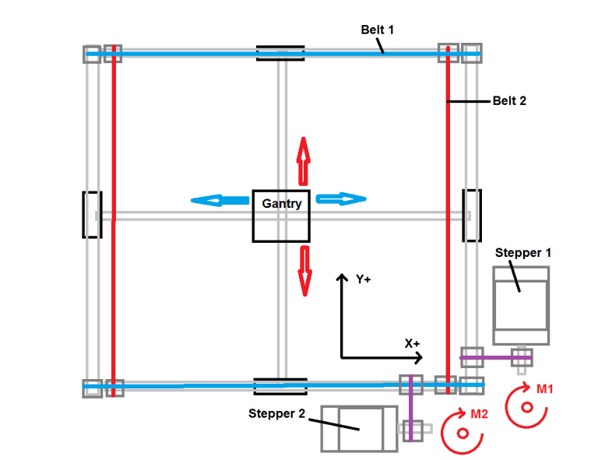
Box design
Two gantries allow movement in X and Y directions
Bed moves in Z direction

Slide 12
Box design
Pros
No print quality degradation on tall models
Still relatively cheap
Can have huge print volume
Cons
More expensive than the Bedslinger
Not as fast as CoreXY/HBOT

Slide 13
Box design: specimens
Ultimaker
Raise 3D
Flying bear
Higher-end printers tend to have really good out-of-the-box performance, and print quality in general. Good for those who want better print quality and ready to pay for it

Slide 14
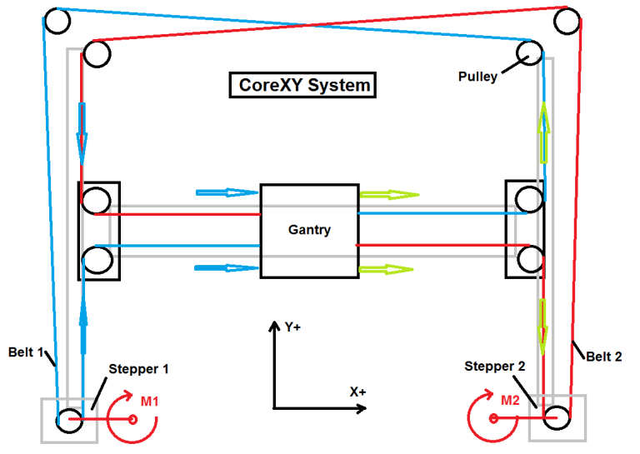
CoreXY and HBot
One gantry that is moved in X direction
Printhead can slide along the gantry in Y direction
Bed is moved in Z direction

Slide 15
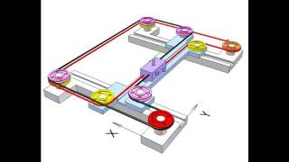
CoreXY video

Slide 16
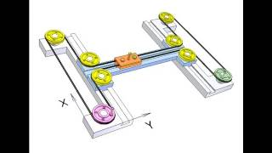
Hbot video

Slide 17
CoreXY and HBot
Pros
Faster than the Box-Style design
Cons
More expensive than Box-Style
Require especially tight tolerances when assembling

Slide 18
CoreXY and HBot: specimens
Voron
Anisoprint A4
Ender 6
For “speed-junkie” type of makers, or for those willing to pay extra for print quality

Slide 19
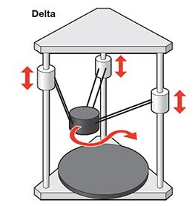
The mighty Delta
Instead of gantries, it uses 3 arms arranged in a triangular fashion
Simultaneous motion of arms controls all 3 axis

Slide 20
Delta
Pros
Fast
Can print tall objects
Compact
Cons
Calibrating is a royal pain
Sensitive to arm length irregularities

Slide 21
Delta: specimens
Pros
Anycubic Kossel
Flsun Q5
Delta Go
For “speed-junkie” type of makers, who are well-versed in the subtle art of 3D printing or for those who want print tall parts.
Aircraft parts, anyone?v

Slide 22
Extruder: Direct vs Bowden

Slide 23
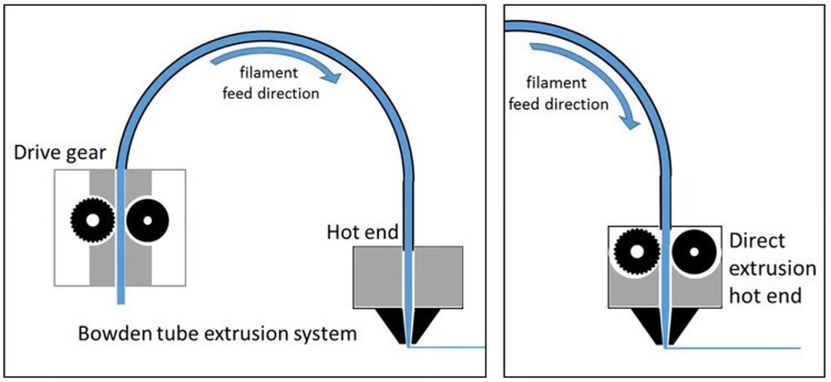
Direct or Bowden?

Slide 24
Bowden pros & cons
Pros
Lighter printhead
Higher speed
Flimsier chassis
Cheaper
Cons
Problems with retracts due to springiness of the material
Hard to print with flexible plastics
Entry-level machines are usually bowdens

Slide 25
Direct pros & cons
Pros
Less problems with the springy filaments
Able to print even softest of TPU plastics
Cons
Heavier printhead
Usually found on higher-end machines
In general, there are less problems with direct extruder

Slide 26
Printer firmware

Slide 27
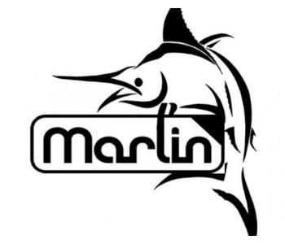
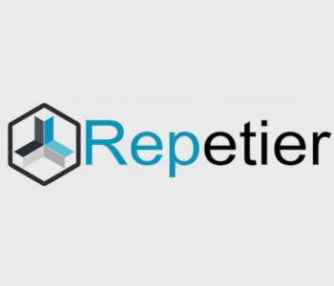


Printer firmware
Klipper
Marlin
Repetier
Prusa & other proprietary

Slide 28
Printer firmware: Main takeaways
If your stock firmware works good enough for you, and that is usually the case with higher end machines - just leave it be
If you want to print faster and possess substantial skill in FDM technomagic, then you can try Klipper
Or maybe you want to print over internet

Slide 29
Printer choice

Slide 30
Hard choice
If you are starting your career in FDM, or want to save money - Bed-slinger printer is a good choice
From there you will figure out what you want next
Tall parts?
Fast prints?
Superb print quality?

Slide 31
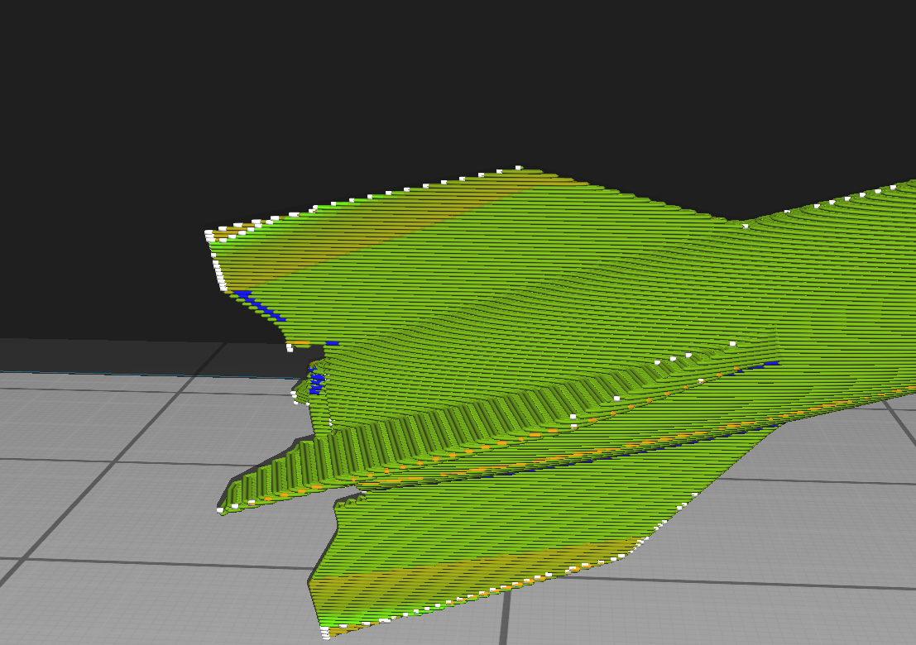
Enough hardware!

Slide 32
Slicing process & Software

Slide 33
Slicing software choice
Cura (free)
Simplify 3D (paid)
Slic3r (free)
PrusaSlicer (free)

Slide 34
Slicing software choice
It is a matter of personal choice, I use Cura because it is
Feature-rich
Extendable via plugins
Actively maintained
Free

Slide 35
Filaments overview
PLA
Easy to print
Strong
Recyclable
Not heat resistant
Hard to machine
PETG
Should be flexible
Strong
Hard to print
Prone to stringing
Very brittle if not dried
ABS
Easy to machine
Easy to smooth with solvent
Extremely poor layer adhesion
Stinks while printing

Slide 36
Print part orientation
Good part has
No layers that are either completely or partially not supported by previous layer
Big print bed contact area
Such an orientation that the main loading is parallel to the bed

Slide 37
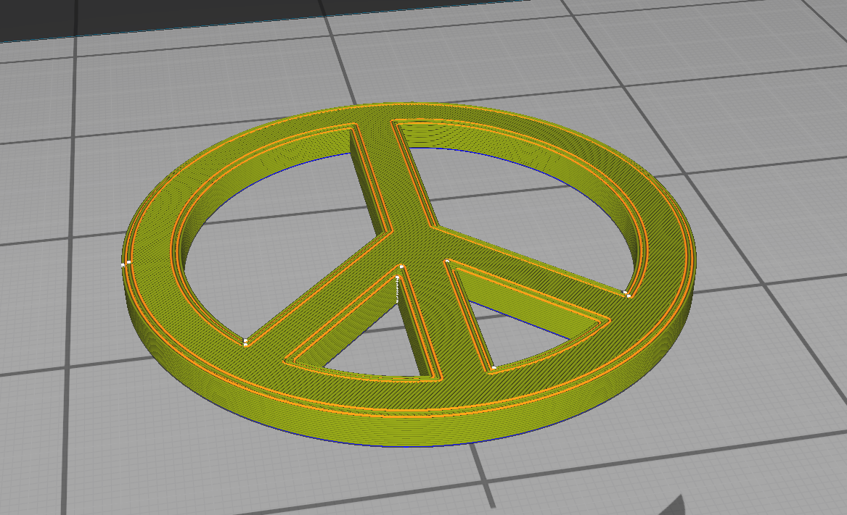
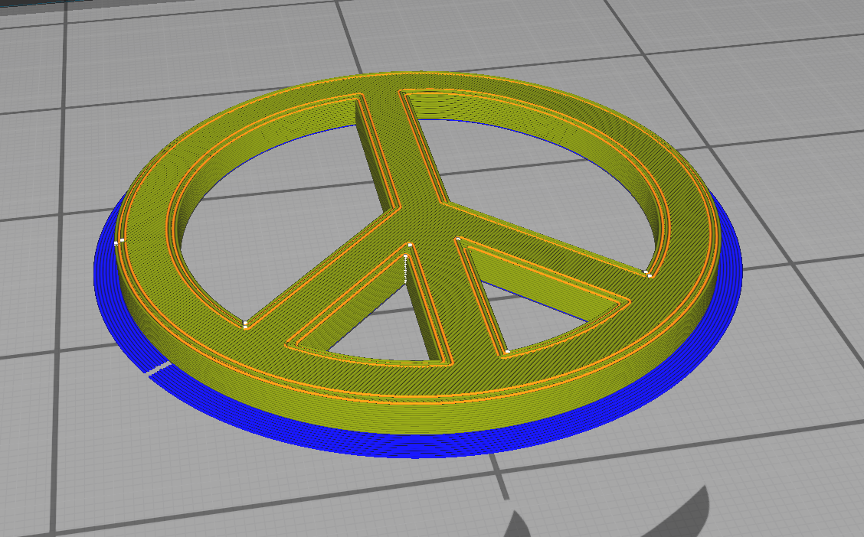
Print part orientation
Good
No partially or fully unsupported layers
Good bed contact area

Slide 38
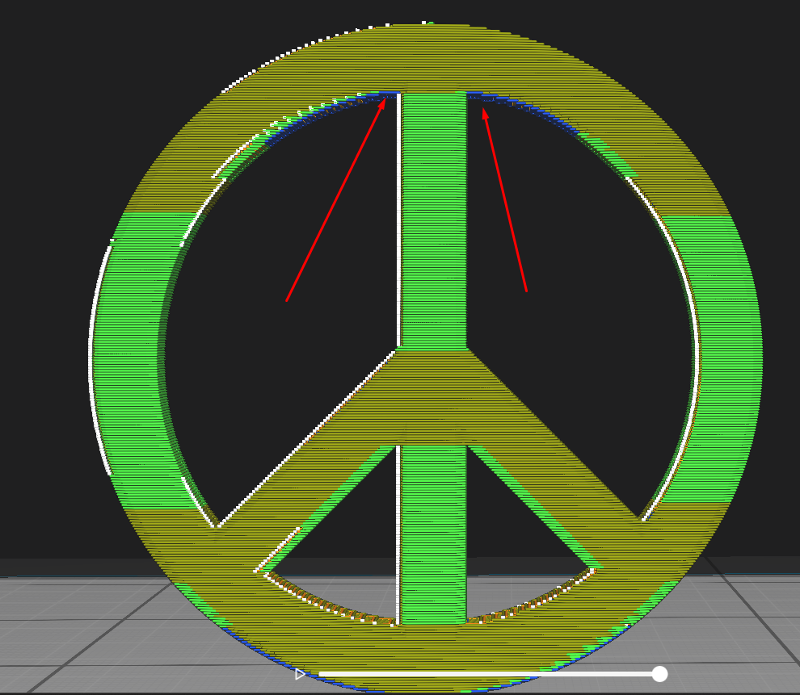
Print part orientation
Poor
Some layers are partially unsupported, like green sides
Some are completely (marked with red arrows)
Low bed contact area
Don’t do this unless you really know what you are doing

Slide 39
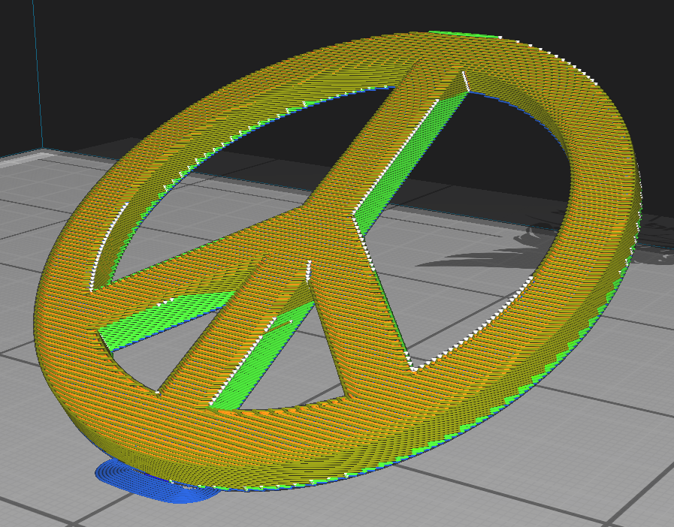
Print part orientation
Extremely poor
Many layers are completely unsupported
Miniscule bed contact area
Don’t do this. Just don’t.

Slide 40
What if you design absolutely needs “bad” parts

Slide 41
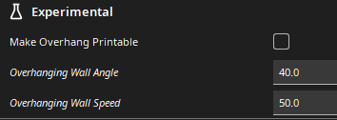
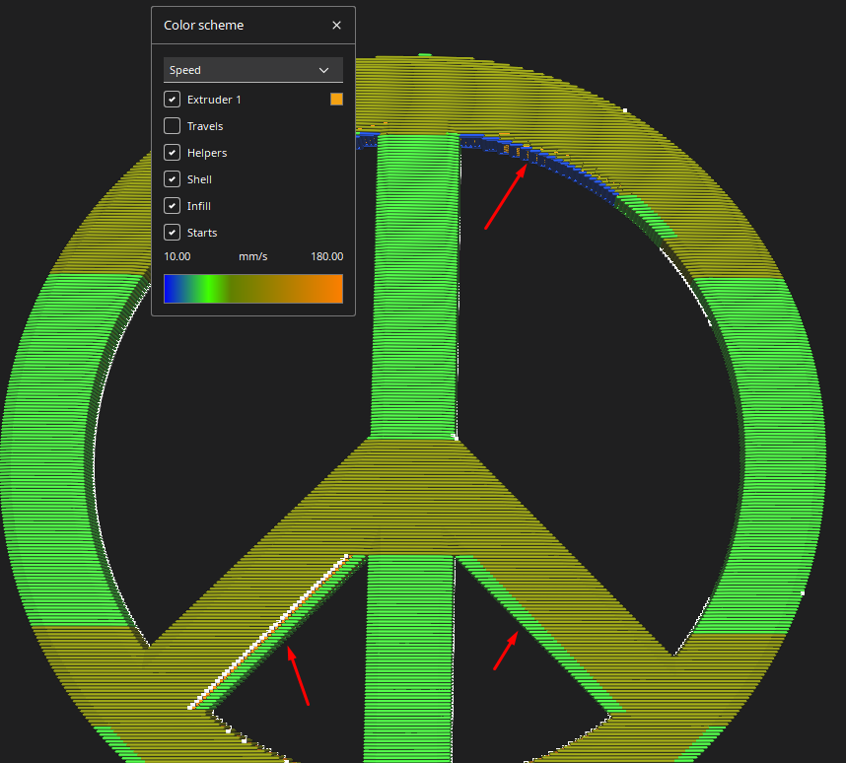
If you really want unsupported print lines
Use overhangs. The main idea is to go slower on partially unsupported lines to prevent sagging
You might want to boost cooling as well
Here are fields that you can tune in Cura (experimental)

Slide 42
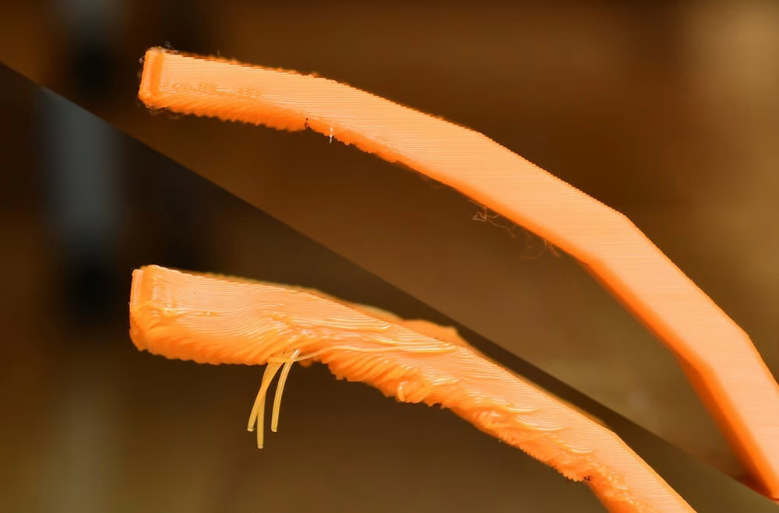
Bad sagging

Slide 43
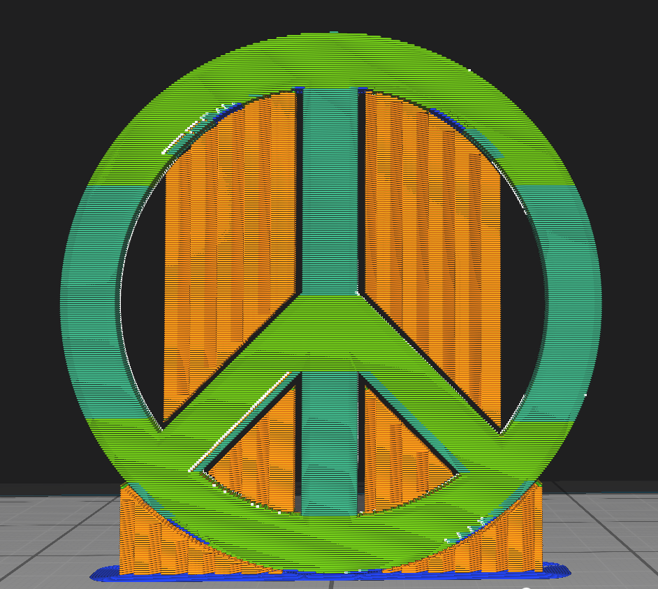
If you really want unsupported print lines
Use support. Support is a sacrificial structure that allows you to print “in the air”
Supports have plethora of parameters, but you should look out for your
Support cooling settings
Top and bottom clearance
Support pattern

Slide 44
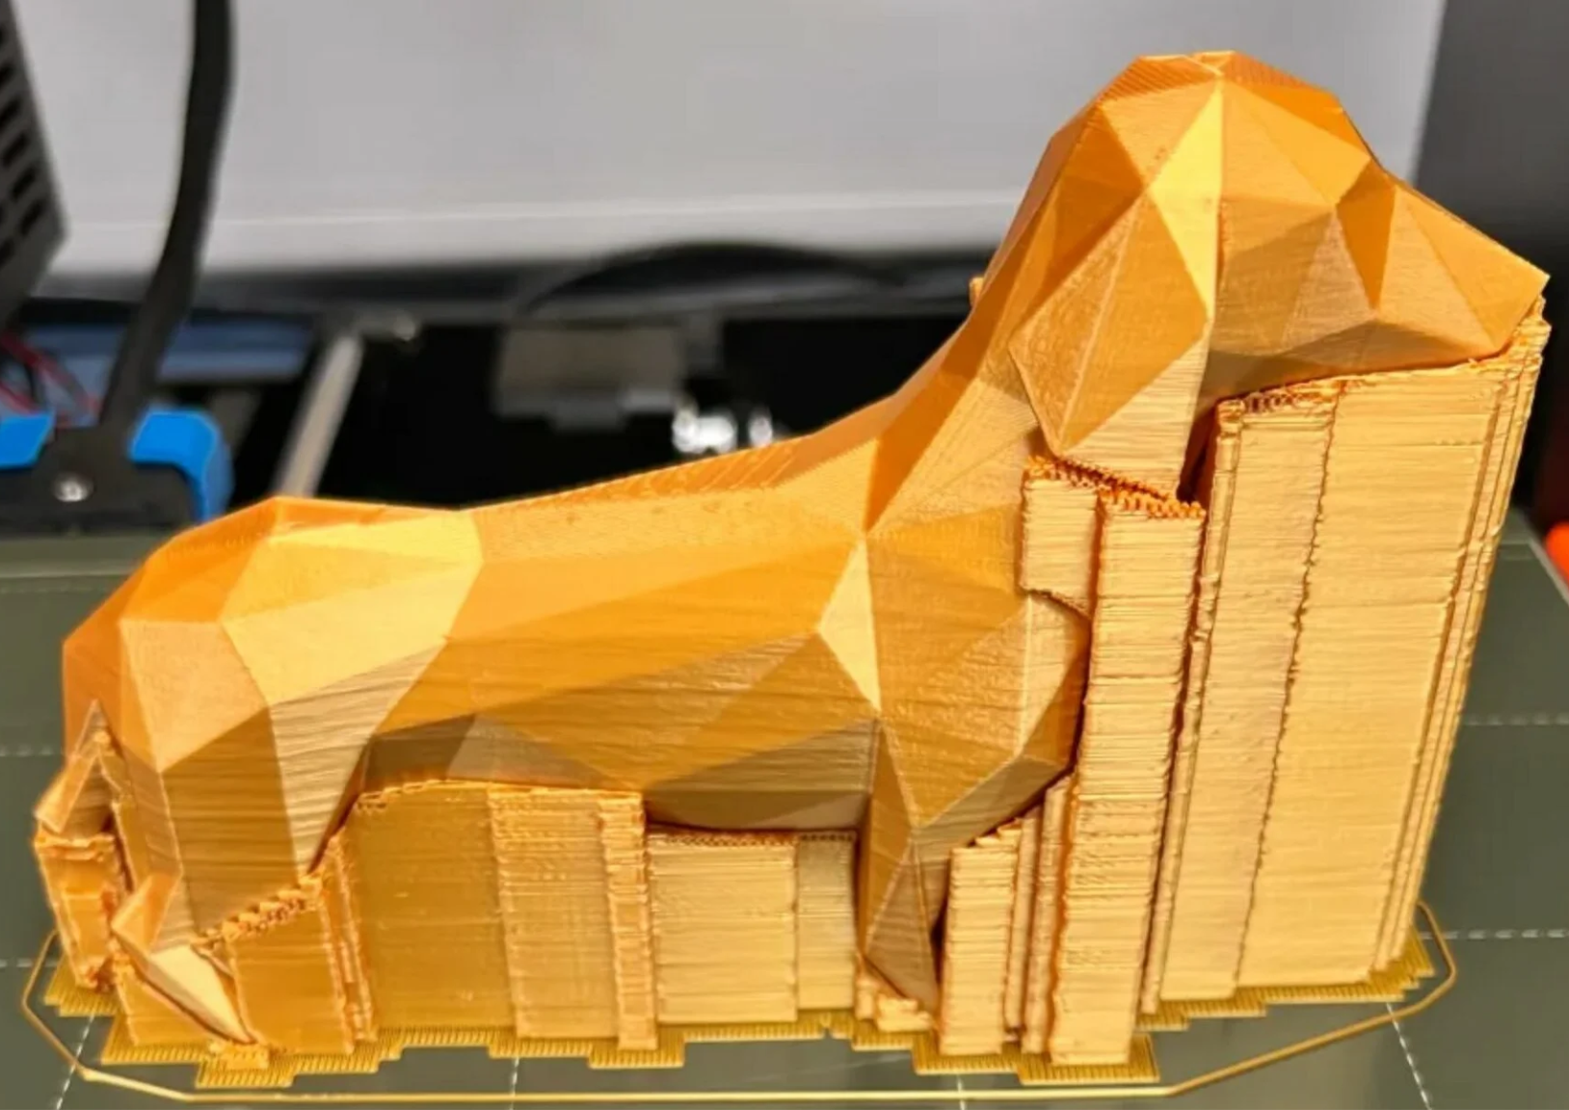
Supports ain’t that bad

Slide 45
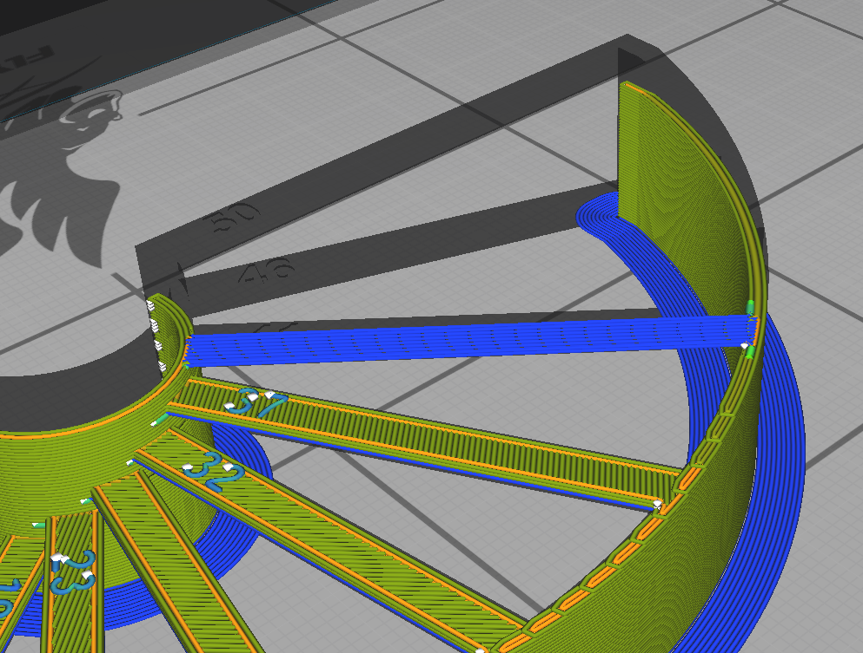
If you really want unsupported print lines
Use bridges. Bridge is printed hanging in the air and is quickly solidified with part cooling fan
Default parameters from Cura usually work for short bridges (up to 2 cm) and machines with adequate cooling

Slide 46
On strong parts and layer adhesion
If you want to make your parts stronger and print faster you might
Ramp up the temperature
Increase line width, i.e. 0.6 for 0.4 nozzle
Decrease cooling, but beware of supports and overhangs!
Some plastics respond better to this technique than others.
More here: https://www.youtube.com/watch?v=9YaJ0wSKKHA&t=736s

Slide 47
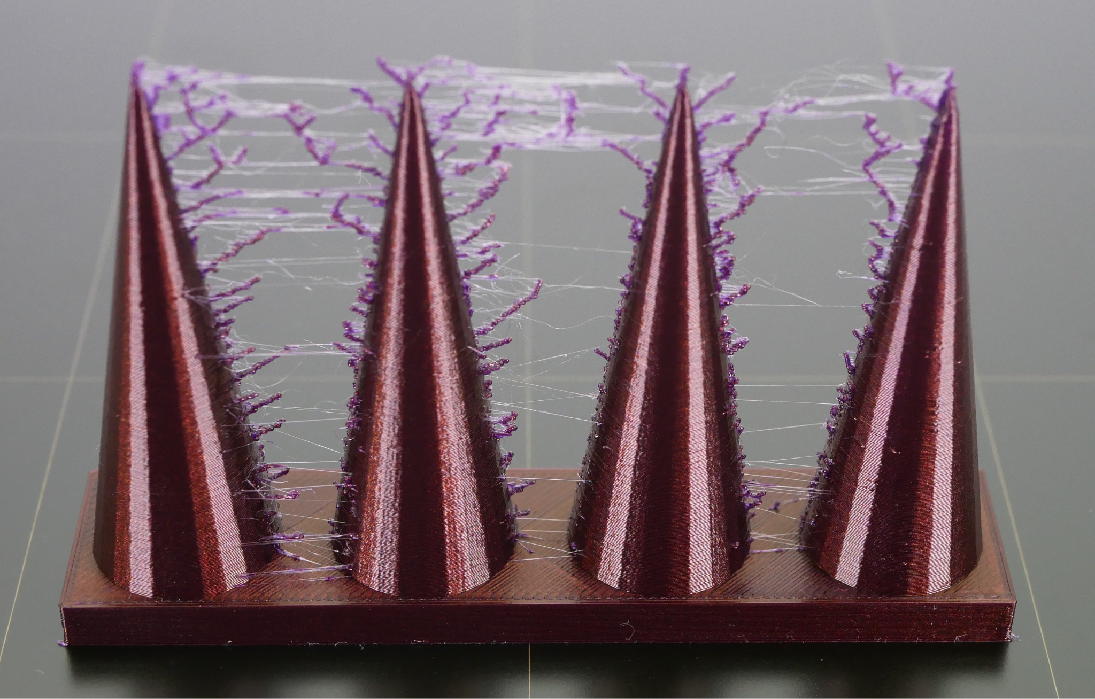
Stringing

Slide 48
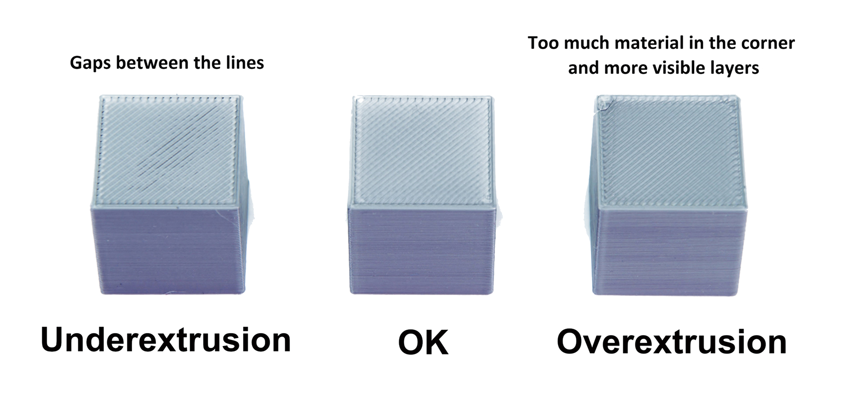
Under/over-extrusion

Slide 49
Post-processing: Gluing

Slide 50
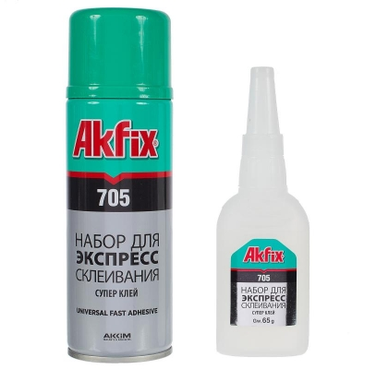
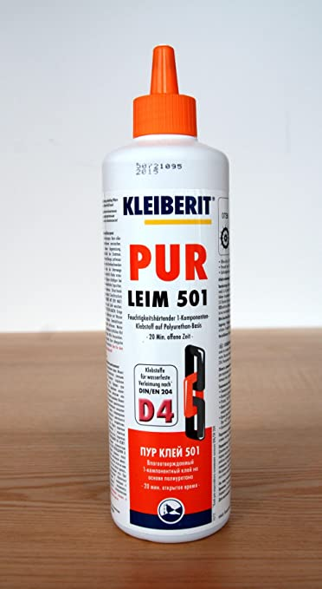
Gluing
Dry-fit first
Maintain high contact surface
Glues suitable for 3D printed parts
CA (possibly with catalyst)
Epoxy
Hot glue
PUR
Glues not suitable for 3D printed parts
UHU Por
PVA glue
Dissolving glues (Dichloromethane / Dichloroethane)

Slide 51
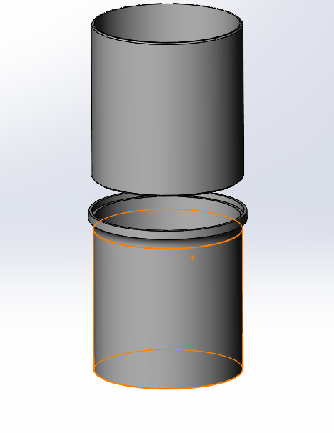
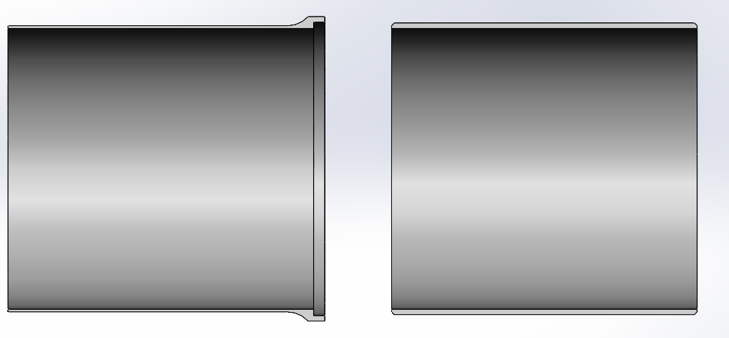
Gluing: Flanges & Dovetail joint

Slide 52
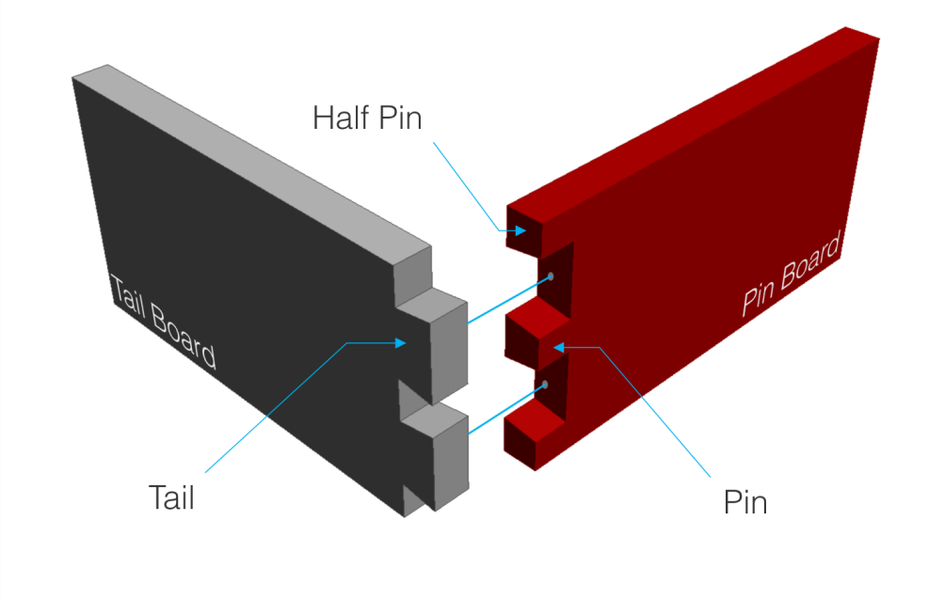
Gluing: Flanges & Dovetail joint

Slide 53
Post-processing: Screwing

Slide 54
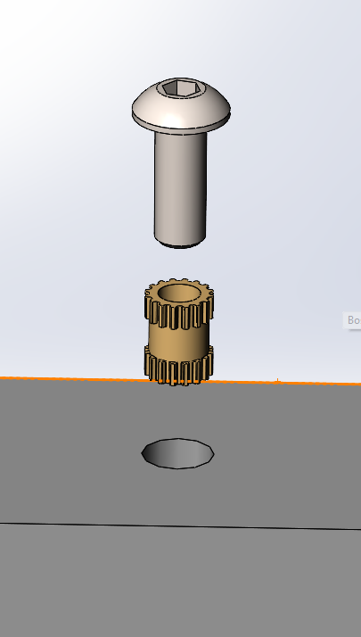
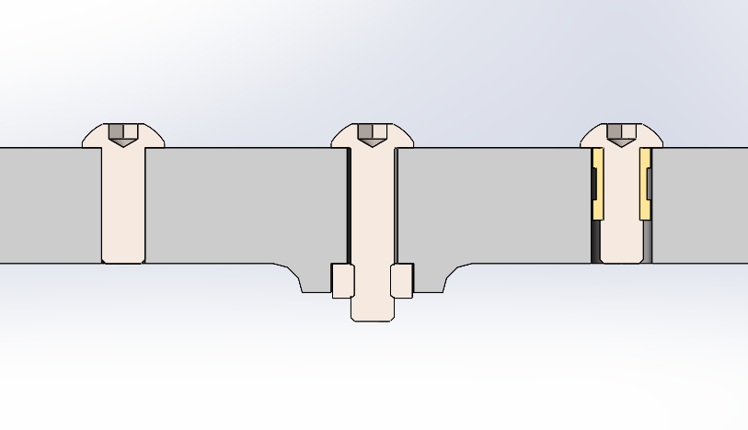
Screwing

Slide 55
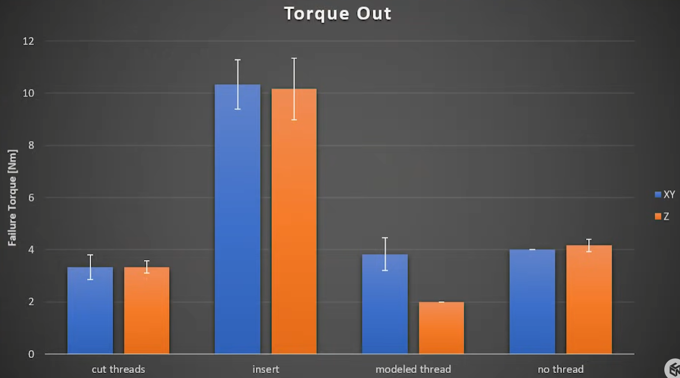
Taken from: https://www.youtube.com/watch?v=iR6OBlSzp7I&t=19s
Visit for more information and scientific tests

Slide 56
Post-processing:
Cutting Drilling Sanding Bathing

Slide 57
Abrasive machining
Sanding should be avoided if possible for plastics like PLA and PETG
If you really want to sand some part- avoid overheating
Cutting with cutoff discs for rotary tool is easier, even if plastic melts. You are just throwing more power to the problem and it apparently works
Beware! A disc can shatter if subjected to bending load
Hand tools like hacksaw will also work

Slide 58
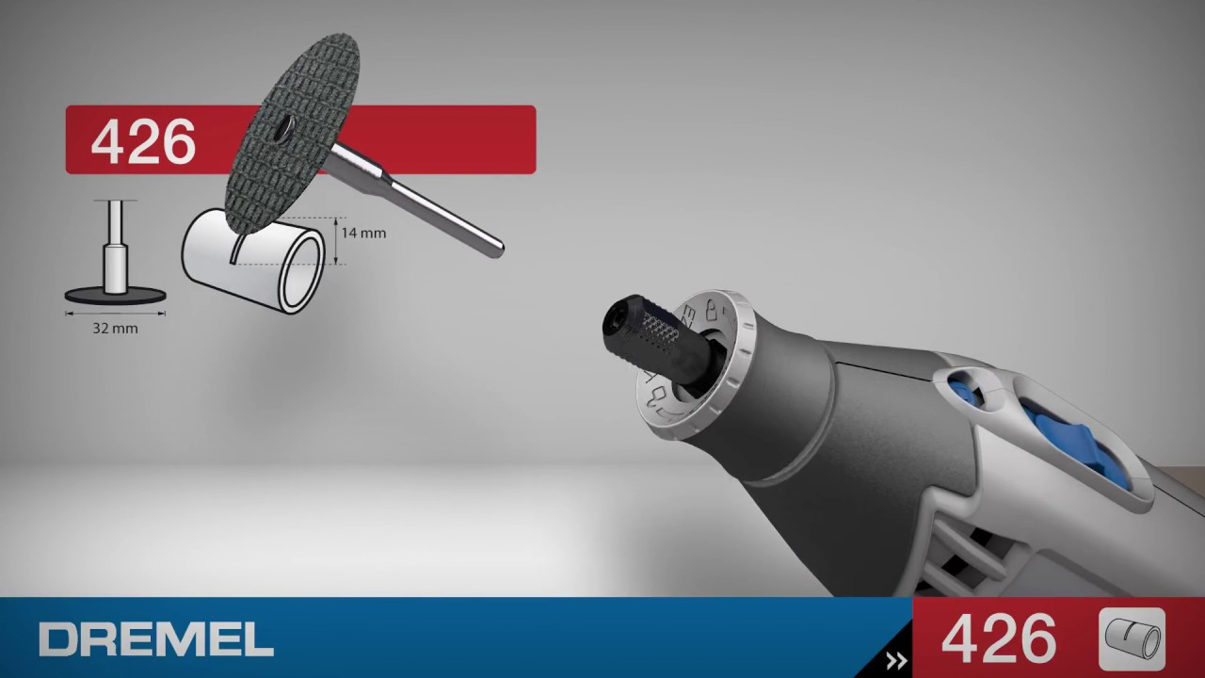

Abrasive machining

Slide 59
Drilling
It is easy to drill 3D printed parts, but there are few caveats
Watch out for the wall thickness
Use a good, sharp drill bit, avoid overheating
Safety first

Slide 60
Drilling
It is easy to drill 3D printed parts, but there are few caveats
Watch out for the wall thickness
Use a good, sharp drill bit, avoid overheating
Safety first

Slide 61
Bathing
Parts are exposed to vapour of a solvent that partially dissolves outer surface
Different plastics require different solvents
ABS: acetone, dichloromethane
PETG: dichloromethane
PLA: limonel, dichloromethane

Slide 62
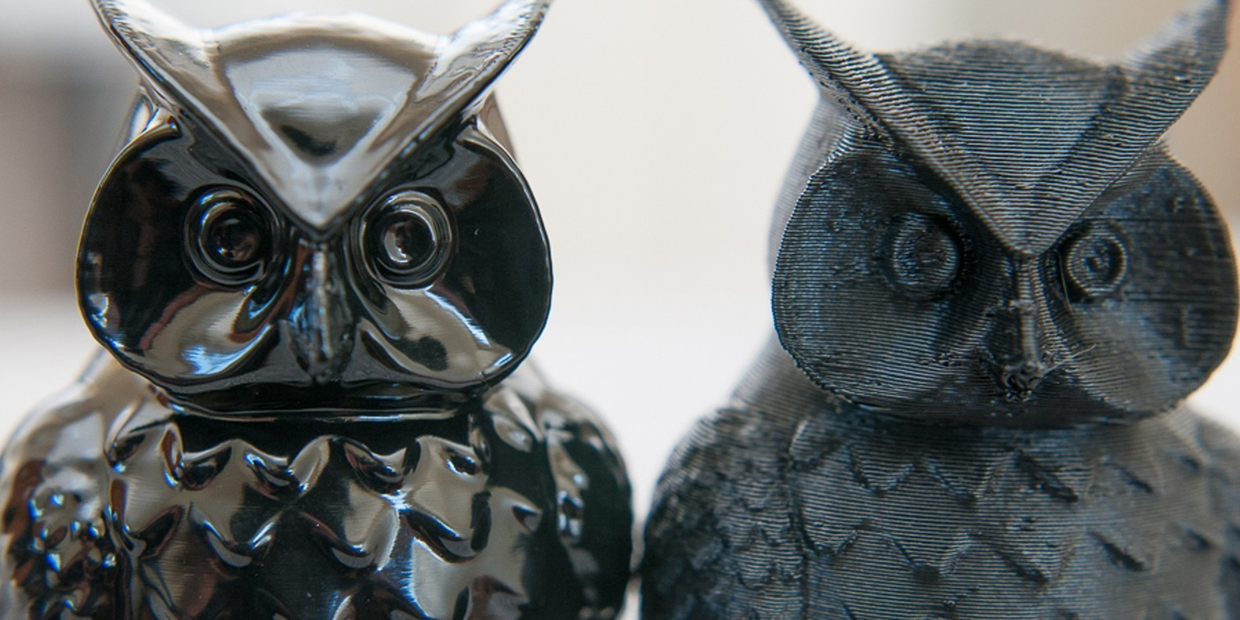
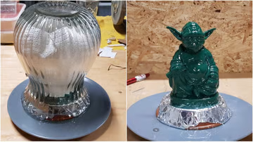
Bathing
Mainly good for decorative parts
Works best with ABS + acetone

Slide 63

Bathing
Most solvents used for bathing are toxic and highly flammable

Slide 64

Tasks: 3D printed joint
Let the 3D modeling commence!
Please scan this QR code and download part for your next tasks

Slide 65
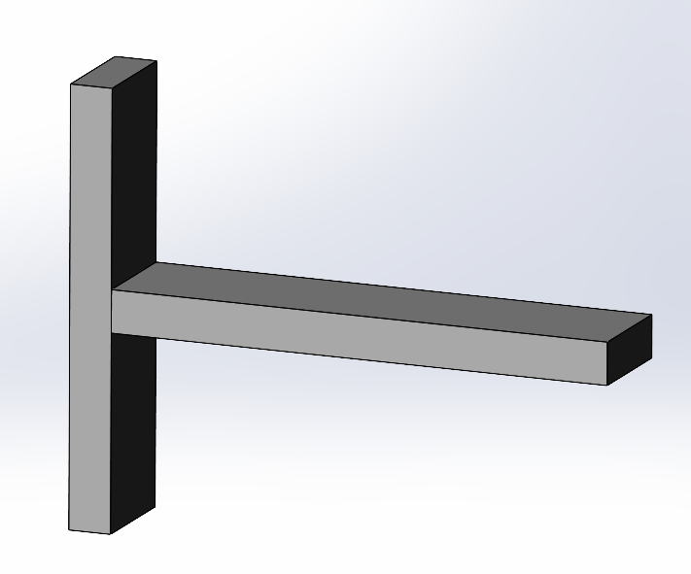
Tasks: 3D printed joint
Your task is to join two parts so that they can be printed and assembled. Please use
Two types of screw joints
Two types of screwless joints
* Take the load applied along the red line into account

Slide 66
Tasks: 3D printed joint
What should you tweak if you want to load your part like this?

Slide 67

That’s it for today!
The Emperor protects!

Slide 68
Do you want to join our lab?
Ever wanted to work on real robotics projects?
Aerial
Ground based
Aquatic
Then you can consider joining our lab, please contact either me @ysukhorukov or my team-lead
@devittdv

